Slide 1

Emotion Recognition For Mental Health Monitoring
​
Member 1: v Sidharrth V (BL.EN.U4AID23054)
Member 2: Dhruv Vijay Kolhe (BL.EN.U4CSE22111)
Member 3: Pranav Gokhale (BL.EN.U4CSE22143)
Member 4: Sathvik Reddy V (BL.EN.U4AIE23127)
Member 5: Hari Haran K (BL.EN.U4AIE23110)
Department of Computer Science and Engineering, Amrita School of Computing, Bengaluru, Amrita Vishwa Vidyapeetham, India

Slide 2
TABLE OF CONTENTS
Problem Definition
Background
Data-Set
Proposed Architecture
Methodology
Algorithms Considered
Results and Analysis

Slide 3
Problem Definition
This project aims to develop a predictive model using Electroencephalogram (EEG) dataset that supports mental health diagnosis and therapy. In this project we strive to classify emotions into four different categories namely happy, sad, neutral and fear.

Slide 4
Background
Emotion recognition using EEG (Electroencephalography) has emerged as a powerful tool in understanding and supporting mental health. EEG captures the brain’s electrical activity through sensors placed on the scalp, allowing researchers to observe changes in brainwave patterns linked to different emotional states. Emotions like happiness, sadness, and stress exhibit unique neural signatures across frequency bands such as alpha, beta, and gamma, making EEG a valuable, non-invasive method for emotion detection.
With the rise of AI and machine learning, it is now possible to build models that analyze EEG signals and accurately classify emotional states in real time. These systems can enhance mental health diagnostics by providing continuous, objective insights into a person’s emotional well-being. In this challenge, we aim to build an AI model that classifies emotions from EEG data and quantifies the neural differences between them—paving the way for smarter, data-driven mental health interventions.

Slide 5
Dataset: Emotions.csv (Bird et. Al)
Challenge: Accurately classifying human emotional states using non-invasive brain signals (EEG) remains a significant goal in Affective Computing and Brain-Computer Interfaces (BCIs).
Approach: This dataset was created to provide controlled, labeled EEG data associated with distinct emotional experiences.
Methodology:
Utilizes a low-cost, commercially available MUSE EEG headband (4 electrodes: TP9, AF7, AF8, TP10) making the approach accessible.
Employs standardized emotional stimuli (film clips) to reliably evoke specific valence categories across participants.
Focus: Targets three fundamental sentiment states:
Positive Valence
Negative Valence
Neutral (Resting Baseline)
Goal: To facilitate research and development of machine learning models capable of classifying emotional sentiment from relatively low-resolution EEG signals, captured under controlled yet realistic conditions (including natural EMG artifacts).

Slide 6
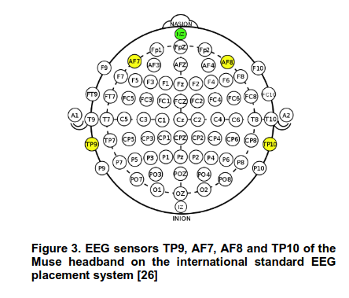

Slide 7
Clips Used For Emotional Stimuli
Film Clips Used as Emotional Stimuli:
The following film clips were carefully selected to induce target emotional states (Negative, Positive, Neutral) during EEG recording:
Negative Emotion (Sadness, Distress, Empathy):
Marley and Me (2008): Dog’s decline and death — participant visibly upset
Up (2009): Opening montage on love and loss — evokes nostalgia and sadness
My Girl (1991): Childhood tragedy — elicits shock and empathy
Positive Emotion (Joy, Amusement, Calm):
La La Land (2016): Musical scenes and romance — joy, happiness
Slow Life (2014): Serene nature footage — calmness, wonder
Funny Dogs (2015): Dog clip compilation — amusement (participant smiled)
Neutral (Baseline):
No Film Stimuli: Resting state with no input — used to establish baseline brain activity

Slide 8
Dataset Features
Signal Preprocessing
Sliding time windows: 3 minute window with 0 seconds of overlap
Sampling rate: 150 Hz (uniform across all recordings)
Initial Feature Extraction
2,548 features extracted per window
Features computed across multiple frequency bands (e.g., Alpha, Beta) and electrodes
Feature Categories (Examples):
Basic Statistical Features
Mean, Standard Deviation, Maximum, Minimum
Higher-order moments (e.g., Skewness, Kurtosis)
Quantiles and value differences
Frequency-Domain Features
Fast Fourier Transform (FFT) coefficients capturing signal amplitude across frequencies

Slide 9
Dataset Features
Relational & Complexity Metrics
Covariance matrix elements
Correlation between electrode signals
Eigenvalues from matrix decompositions
Log-determinant and matrix logarithm-based features
Entropy (signal unpredictability or complexity)

Slide 10
Feature Descriptions
Mean:
Represents the average voltage level (signal baseline).
Standard Deviation:
Indicates signal variability; higher values reflect increased neural firing fluctuations.
Maximum & Minimum:
Capture the peak positive and negative amplitudes, reflecting the extent of signal excursions.
Skewness:
Measures the asymmetry of the signal distribution.
Kurtosis:
Indicates the "tailedness" or frequency of extreme deviations.
Significance:
These features capture fundamental properties of brain activation and stability, which may vary with different emotional states (e.g., heightened arousal may increase variability and signal excursions).

Slide 11
Feature Descriptions – Frequency Domain
FFT Coefficients:
Represent amplitude and phase across discrete frequency bins.
Power Spectral Density (PSD):
Measures how power is distributed across standard EEG frequency bands (Delta, Theta, Alpha, Beta, Gamma).
Differential Entropy (DE):
Quantifies the complexity or information content within each frequency band.
Significance for Emotion:
Alpha (8-14 Hz): Linked to relaxation (higher power) or active processing (lower power). Frontal alpha asymmetry is notably studied for approach/withdrawal motivation.
Beta (14-31 Hz): Associated with active thinking, concentration, motor activity, and sometimes anxiety or stress.
Gamma (31-50+ Hz): Tied to higher cognitive functions, sensory binding, attention, and potentially the intensity or richness of conscious experience.
Theta (4-8 Hz) & Delta (1-4 Hz): Reflect aspects of memory processes, drowsiness, emotional regulation (Theta), and deep brain states (Delta).

Slide 12
Feature Descriptions – Relational Features
Covariance & Correlation:
Measure the degree of synchrony and linear relationship between signals from different electrodes.
Eigenvalues (from Covariance Matrix):
Represent dominant modes of variance, highlighting coordinated network activity.
Complexity Metrics
Entropy:
Captures the unpredictability or randomness of the signal, indicative of signal complexity.
LogM (Log-determinant Features):
Summarizes the global spread of multi-channel signals, reflecting large-scale network properties.
Significance:
These features capture inter-electrode relationships and overall network dynamics, providing insight into how distributed neural activity reorganizes during various emotional states.

Slide 13
Dataset: SEED-IV (Wei-Long Zheng et al.)
Dataset generation:
72 video clips chosen for preliminary study
Study's tendency to induce happiness, sadness, fear or neutral emotions.
No of subjects: 15
Three sessions per participant on three different days.
24 trials per session.

Slide 14
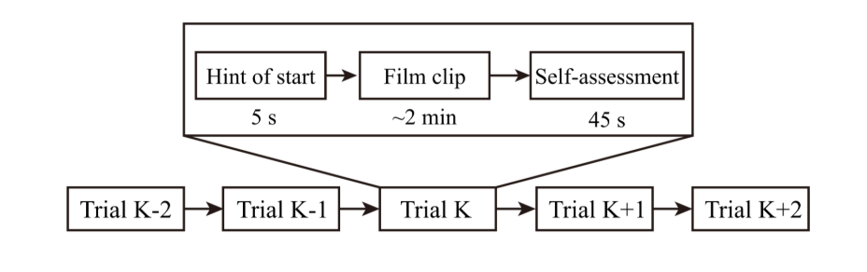
EEG signals and eye movements collected when participant watches video clips.
Schedule diagram of trial:

Slide 15
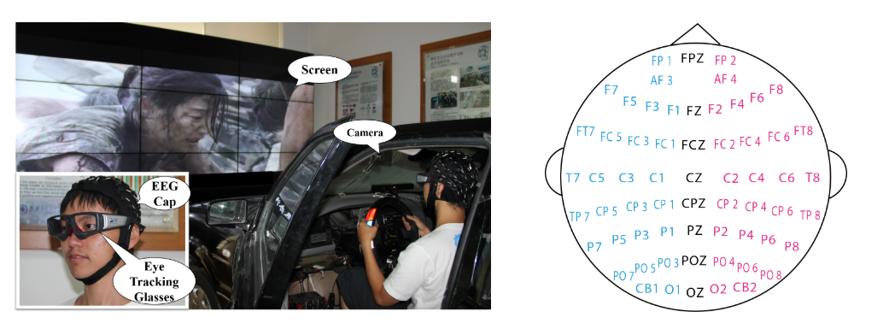
Experimental scene and electrode placement

Slide 16
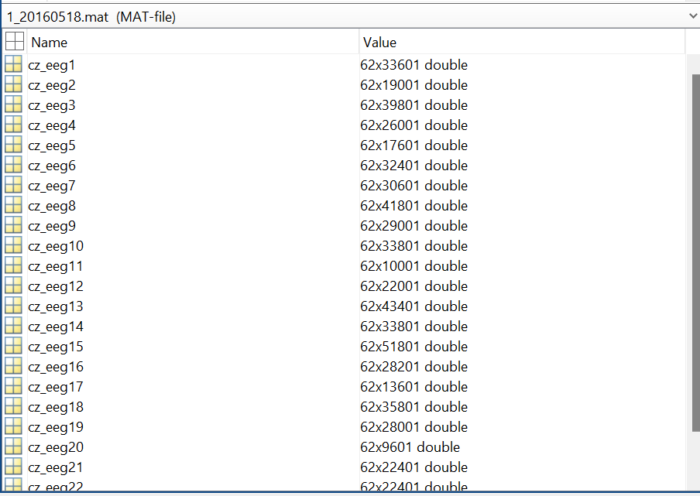
Dataset Summary
The "eeg_raw_data" folder contains the raw EEG signals of the 15 participants. The inner 3 folders named '1', '2' and '3' correspond to the 3 sessions. Each ".mat" file (named with {SubjectName}_{Date}.mat) in the folders stores a structure with fields named "cz_eeg1", "cz_eeg2", ... , "cz_eeg24", which correspond to the EEG signals recorded during the 24 trials.

Slide 17
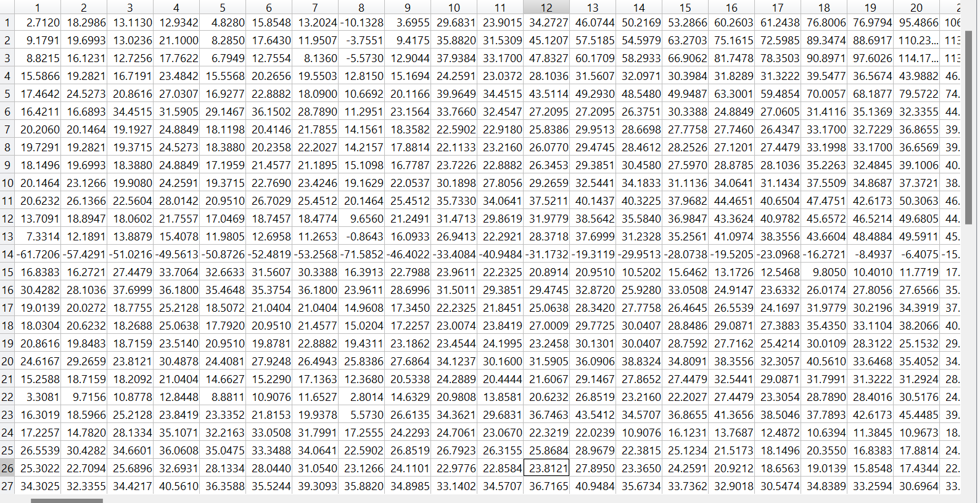
Rows (1 to 62) represent the EEG channels (electrodes)
Columns (1 to 33601) are the time-series data points for that channel
cz_eeg1
Each value we see is the EEG voltage value at a particular time point for a given channel

Slide 18
Methodology Used For Emotions.csv
Model Comparison: We investigated the performance of several deep learning architectures suitable for sequential or spatio-temporal data, including:
Recurrent Neural Network (RNN)
Long Short-Term Memory (LSTM)
Gated Recurrent Unit (GRU)
Convolutional Neural Network (CNN)
Evaluation Strategy:
Data Split: Standard 70% / 30% Train-Test split applied uniformly across models.
Training: Each model was trained independently on the 70% training portion.
Testing: Performance was evaluated on the held-out 30% test set.
Primary Metric: Classification Accuracy (Percentage of correctly predicted emotional states on the test set) was used to compare model effectiveness.

Slide 19
Methodology Used For Seed dataset
Feature extraction:
Slicing: 4 seconds non overlapping segments.
Down sample the EEG data to 200 Hz.
Removal of noise and artifacts by processing EEG data with a bandpass filter between 1 Hz and 75 Hz.
Power Spectral Density (PSD) and Differential Entropy (DE) within each segment extracted at 5 frequency bands.
1) delta: 1~4 Hz; 2) theta: 4~8 Hz; 3) alpha: 8~14 Hz; 4) beta: 14~31 Hz; and 5) gamma: 31~50 Hz.
Resulting information stored in eeg_feature_smooth directory.

Slide 20
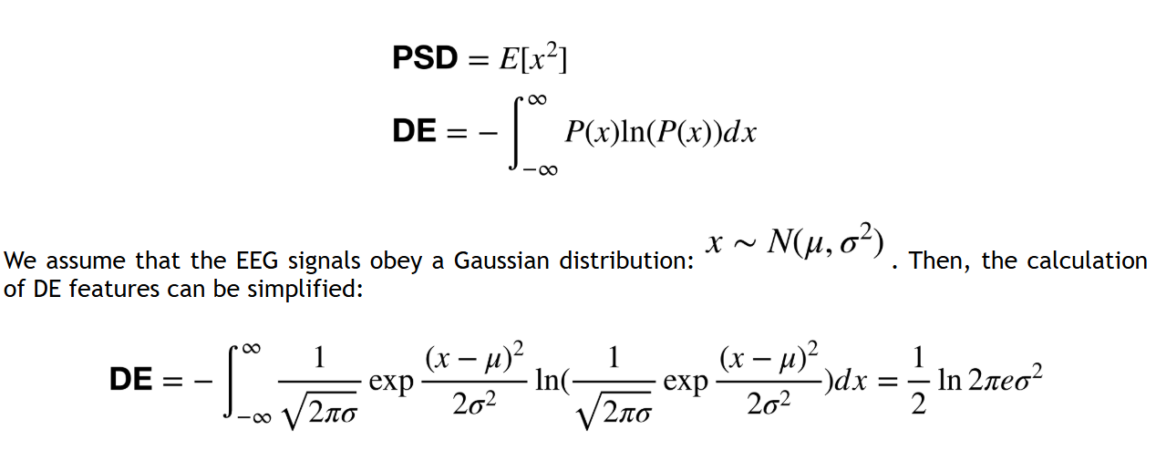
Additionally eye movement features such as the pupil diameter, fixation, saccade, and blink also extracted.

Slide 21
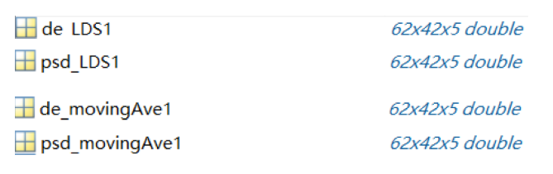
eeg_feature_smooth directory
The "eeg_feature_smooth" folder has the same structure as in eeg_raw_data. Each ".mat" file stores a structure with fields named "{X}_{Y}{Z}". The "X" indicates the type of feature, which can be "psd" or "de". "Y" indicates the type of smoothing method, which can be "movingAve" or "LDS". Linear dynamic system (LDS) and moving averages are two different approaches to filter out noise and artifacts that are unrelated to EEG features. The "Z" indicates the trial number. Each field is in the shape of channel_number*sample_number*frequency_bands, in other words, 62*W*5, where W indicates the number of time windows in that trial (different trials have different W because the film clips are not of the same length).

Slide 22
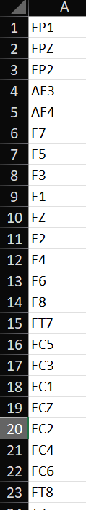
The "Channel Order.xlsx" file lists the channel names in the EEG placement figure in the order of the channels in the EEG raw data provided in the "eeg_raw_data" folder.
The "ReadMe.txt" file demonstrates the label of each trial in each session and some other additional information.
Label:
The labels of the three sessions for the same subjects are as follows,
session1_label = [1,2,3,0,2,0,0,1,0,1,2,1,1,1,2,3,2,2,3,3,0,3,0,3];
session2_label = [2,1,3,0,0,2,0,2,3,3,2,3,2,0,1,1,2,1,0,3,0,1,3,1];
session3_label = [1,2,2,1,3,3,3,1,1,2,1,0,2,3,3,0,2,3,0,0,2,0,1,0];
The labels with 0, 1, 2, and 3 denote the ground truth, neutral, sad, fear, and happy emotions, respectively.

Slide 23
Load the dataset.
Define the channel coordinates and channels.
Initialise an array of 24 to obtain:
15 subjects (participants) → len(directories)
3 sessions per subject → len(os.listdir(directories[0]))
24 trials per session → n = 24
4 feature types → perSample = ['de_movingAve', 'de_LDS', 'psd_movingAve', 'psd_LDS']
8x9 electrode layout → 2D spatial layout
5 frequency bands
64 time windows or segments (often for temporal slicing)
Map channel names to coordinates.

Slide 24
Restructure the data to make it ready for model input, where:
Each row (sample) corresponds to a unique trial.
The rest of the dimensions hold the spatiotemporal feature representation.
Makes it easy to split into training/testing and feed into CNN/ConvLSTM2D.

Slide 25
Models Used:
emotions.csv
GRU
LSTM
CNN
RNN
SVM
Logistic Regression
Decision Tree
Random Forest
SEED IV
LSTM
CNN
CNN+LSTM

Slide 26
Feature | RNN | GRU | LSTM | CNN | SVM
Type | Neural Network (Sequential) | Neural Network (Gated RNN) | Neural Network (Gated RNN) | Neural Network (Spatial) | Non-NN (Kernel-Based)
Memory Mechanism | Single hidden state | 2 gates (Reset/Update) | 3 gates (Input/Forget/Output) | Filters/Kernels | N/A (Uses support vectors)
Data Type | Sequential (Time/Text) | Sequential | Sequential | Grid (Images, Signals) | Tabular/Sequential*
Long-Term Dep. | Poor | Good | Best | None | None
Speed (Training) | Fast | Faster than LSTM | Slow (Deep) | Fast (Parallelizable) | Very Fast (Small Data)
Speed (Inference) | Medium | Medium | Medium | Fastest | Fast
Scalability | Poor (Long Sequences) | Good | Good | Excellent | Poor (Large Datasets)
Interpretability | Low | Low | Low | Medium (Visualizations) | High (Decision Boundary)
Hyperparameters | Hidden units, Layers | Hidden units, Gates | Hidden units, Gates | Filters, Strides, Pooling | Kernel (RBF/Linear), C
Best For | Simple sequences | Medium sequences | Long sequences | Local patterns | Small/medium tabular data
Key Weakness | Vanishing gradients | Moderate memory | Computationally heavy | Weak on sequential order | Fails with huge datasets
Typical Use Cases | Time-series (basic) | Speech recognition | Machine translation | Image classification | Structured data classification

Slide 27
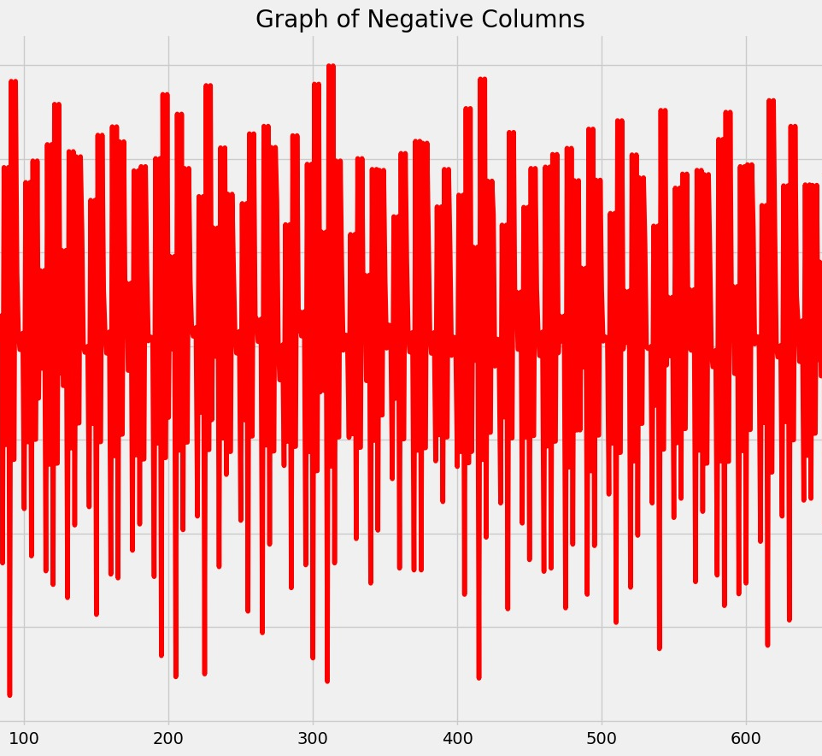
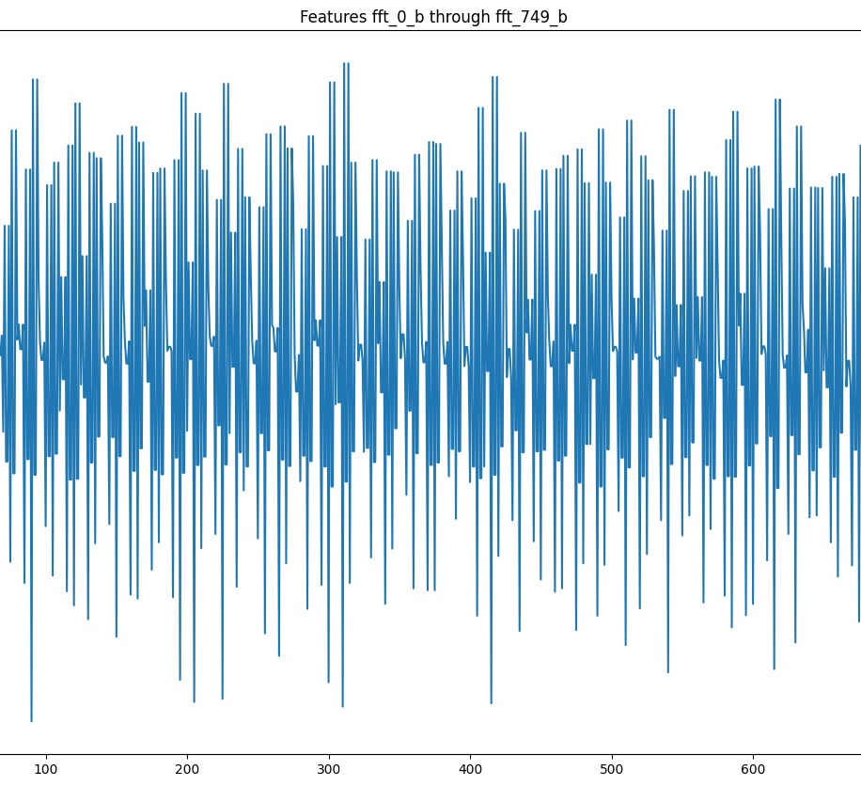
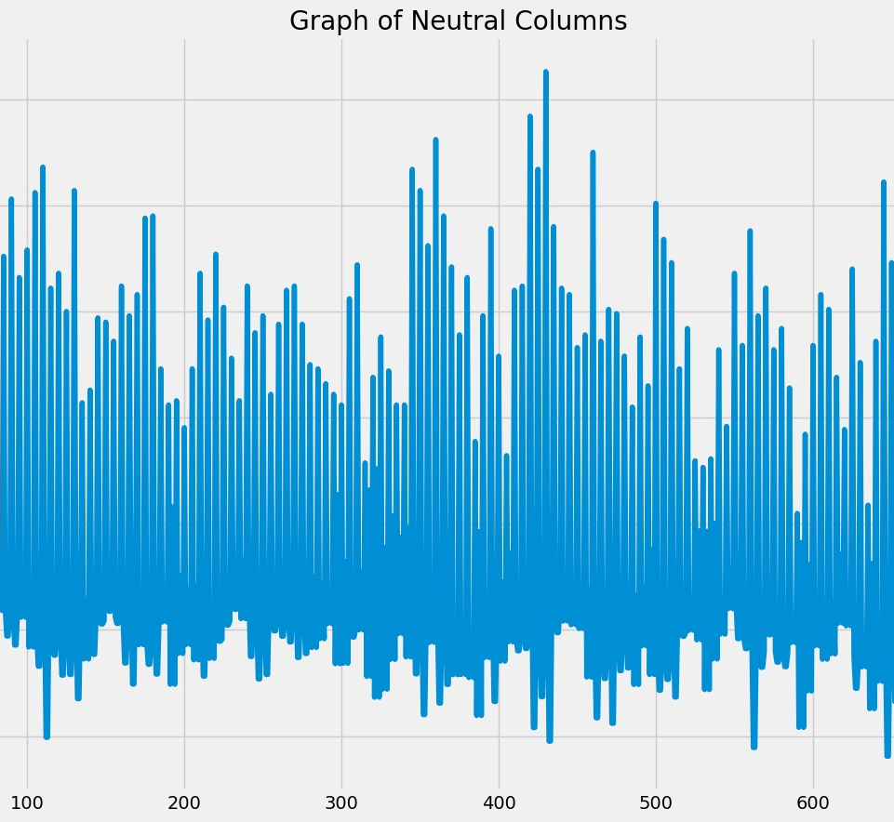
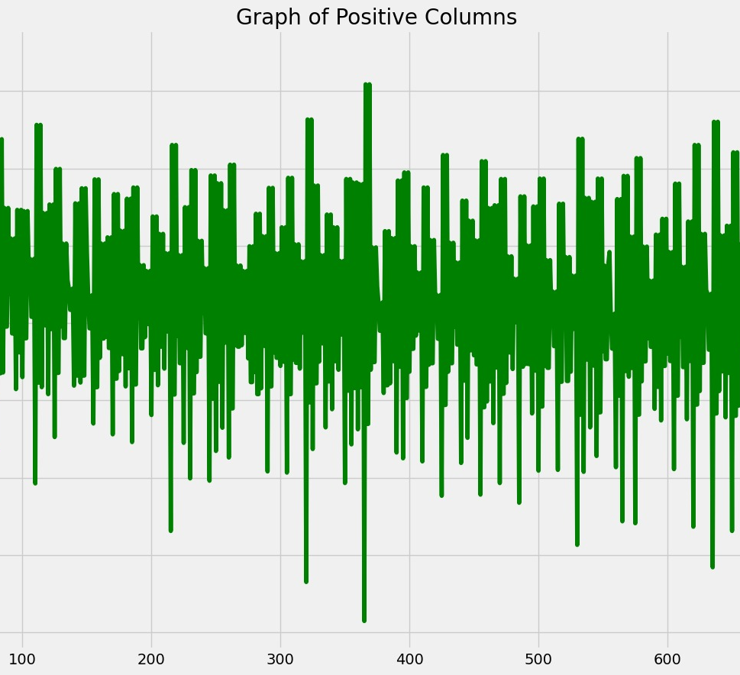
Results for Emotions.csv

Slide 28
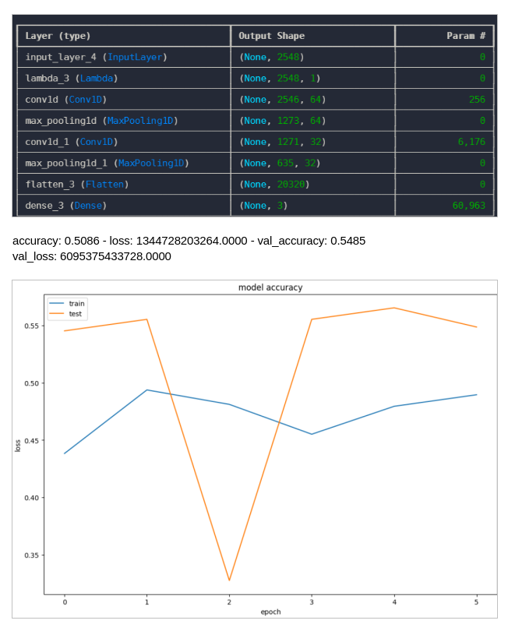
CNN

Slide 29
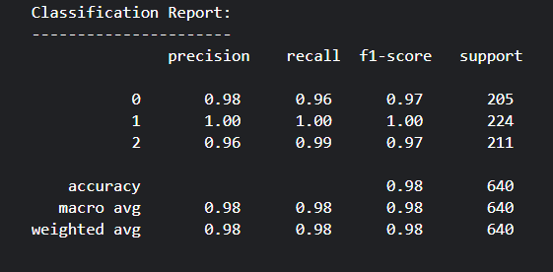
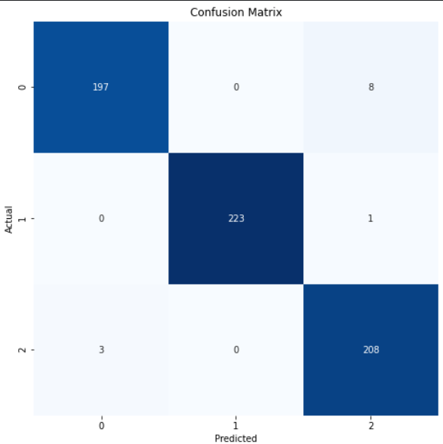
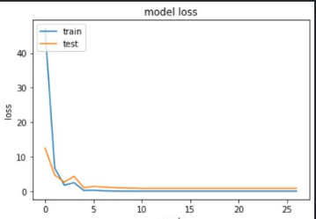
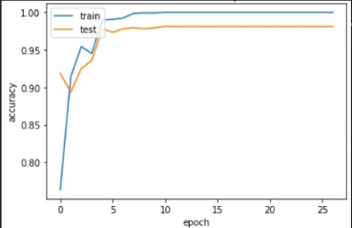
GRU
loss: 8.9904e-11 accuracy: 1.0000 val_loss: 0.8092 val_accuracy: 0.9812

Slide 30
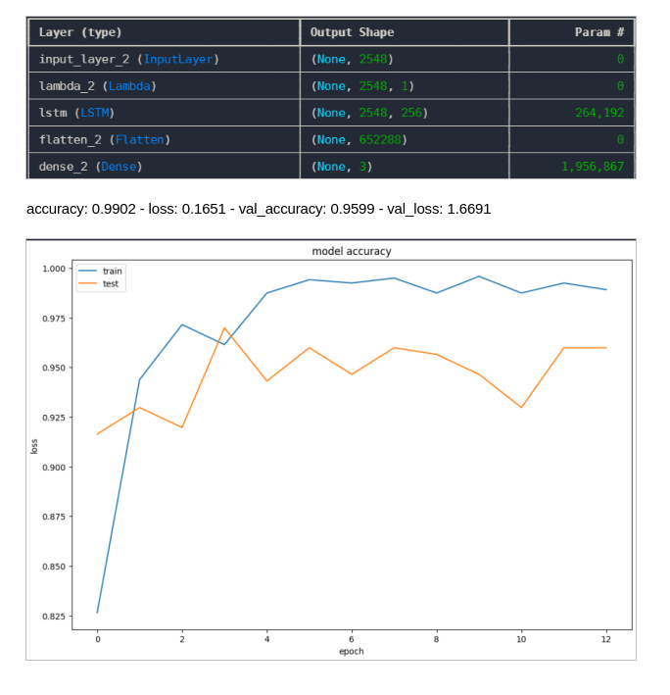
LSTM

Slide 31
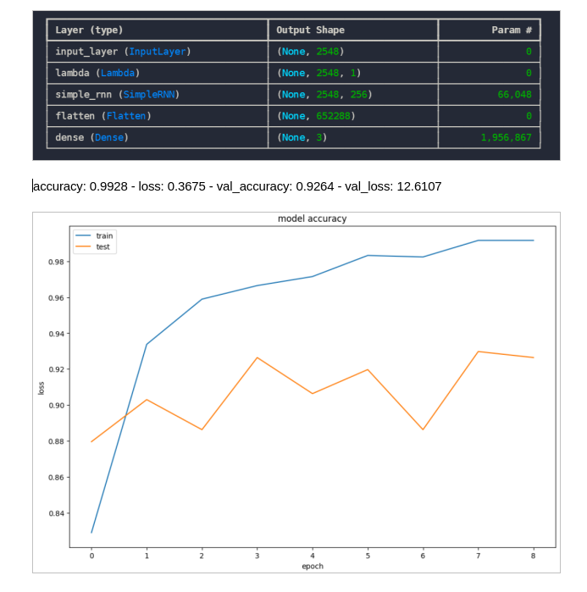
Simple RNN

Slide 32
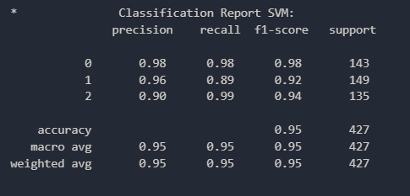
SVM

Slide 33
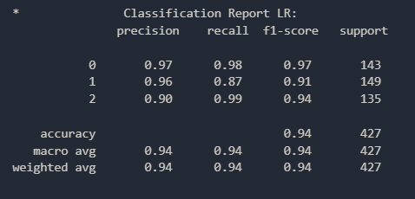
Logistic Regression

Slide 34
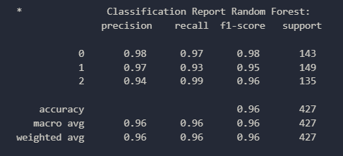
Random Forest

Slide 35
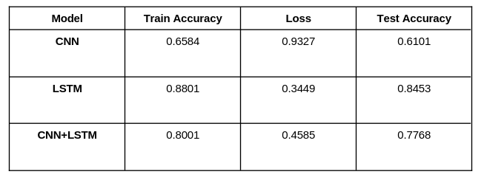
Results for SEED-IV

Slide 36
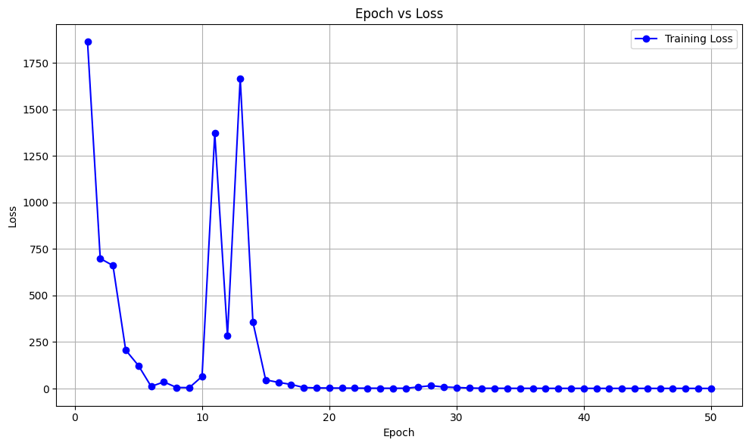
Epoch vs Loss(CNN)

Slide 37
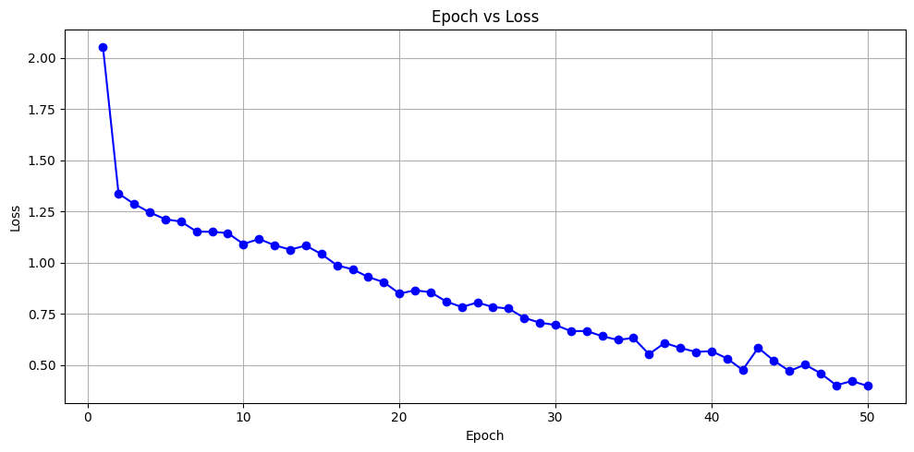
Epoch vs Loss(LSTM)

Slide 38
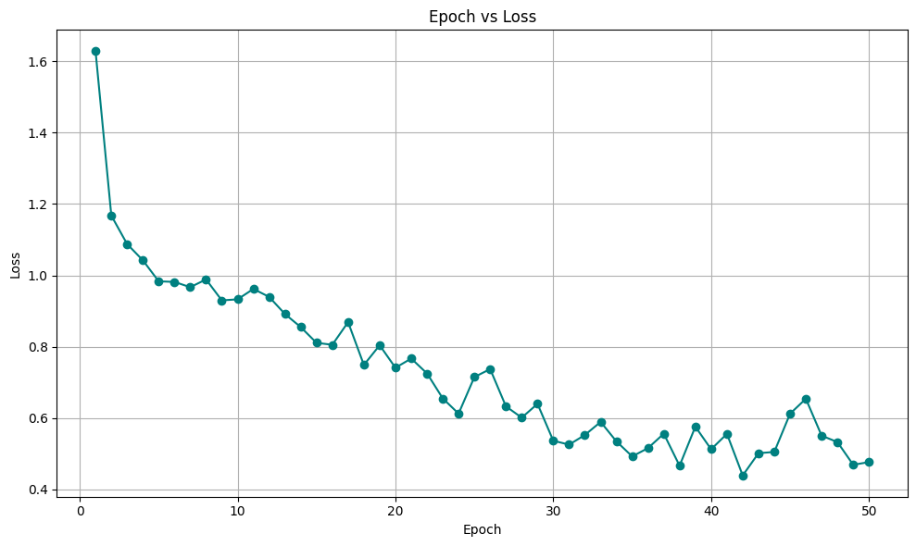
Epoch vs Loss(CNNLSTM2D)

Slide 39
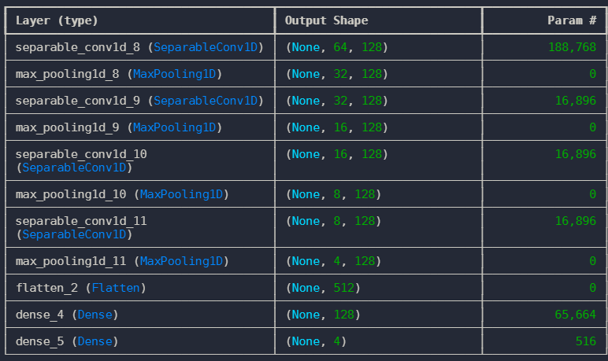
CNN (SEED-IV)

Slide 40
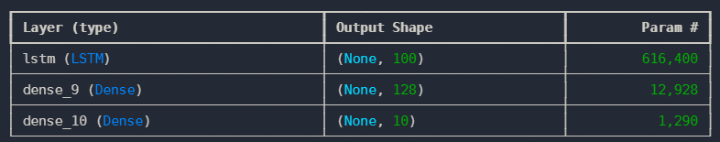
LSTM (SEED-IV)

